Slide 1


Balloon Shooter 3D

Slide 2



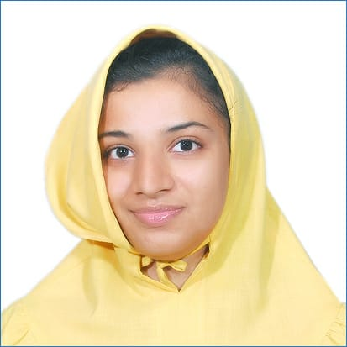


Team Introduction
Akash Bansod
Team Lead
Saurabh Bhushan Pinkar Kumari
Zenab Sultan
Abhijeet Soni Aayush Joshi

Slide 3
Agenda
Problem Statement
Introduction to game
Work distribution
Time and technology used

Slide 4
Problem Statement
Keyboard based balloon shooting game, where a player need to move gun pointer through the keyboard navigation keys.
A player can shoot as many as balloon in 2 minute time.
+10 points will be given for each shoot.
Game should support navigation buttons.
Player can share the game on facebook.

Slide 5
Introduction to Game
Balloon shooting is a fun and popular carnival game of skill - Aim and Hit the Target . It is an addictive shooting game in which player shoot floating balloons of different colors in the air, using gun. You just have to aim and hit the balloons with bullet. Players aim the floating balloons and earn a score based upon the number of balloons successfully ruptured. You need to click to fire bullet to hit the balloons.
Player – single player
Features: - Difficulty increases as level increase. - Easy to play with one mouse control. - Used high quality graphics for best effect. - Realistic balloon blast sounds. - Rich visual effects and addictive game play mechanism.
-Player can change weapons while playing.

Slide 6
Work Distribution
Members | Modules
Saurabh Bhushan | Scene, Timer, UI
Zenab Sultan | Skybox, Map
Pinkar Kumari | Skybox, Crosshair, UI
Aayush Joshi | Shooter, Bullets, Balloons
Abhijeet Soni | Shooter, Hosting, Facebook Sharing
Akash Bansod | Script and testing

Slide 7
Time and Technology Used
Time – 42 hours
Technology Used – javascript , Threejs and facebook SDK.
- JavaScript is the programming language of HTML and the Web. JavaScript is easy to learn.
Web pages are not the only place where JavaScript is used. Many desktop and server
programs use JavaScript. Node.js is the best known. Some databases, like MongoDB and
CouchDB, also use JavaScript as their programming language.
- Three.js is the world's most popular JavaScript framework for displaying 3D content on the
web, providing you with the power to display incredible models, games, music videos,
scientific and data visualizations, or pretty much anything else you can imagine, right in your
browser and on your smartphone!
Tools Used - 3D Builder, Visual Studio, 000webhost
Percentage completion – 70%
Url - https://balloonshooter3d.000webhostapp.com/

Slide 8
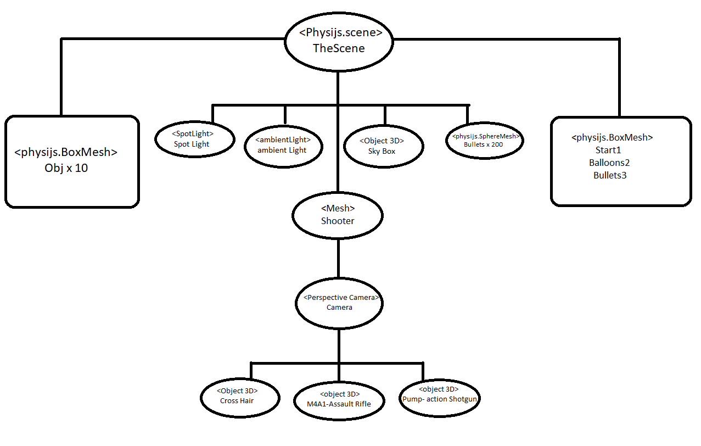
Flow Diagram

Slide 9
Thank You!

